Slide 1
MOOD DISORDERS
Depression
By
F. Muvea

Slide 2
Definition
Depression is a common mental disorder, characterized by sadness, loss of interest or pleasure, feelings of guilt or low self-worth, disturbed sleep or appetite, feelings of tiredness and poor concentration (WHO).

Slide 3
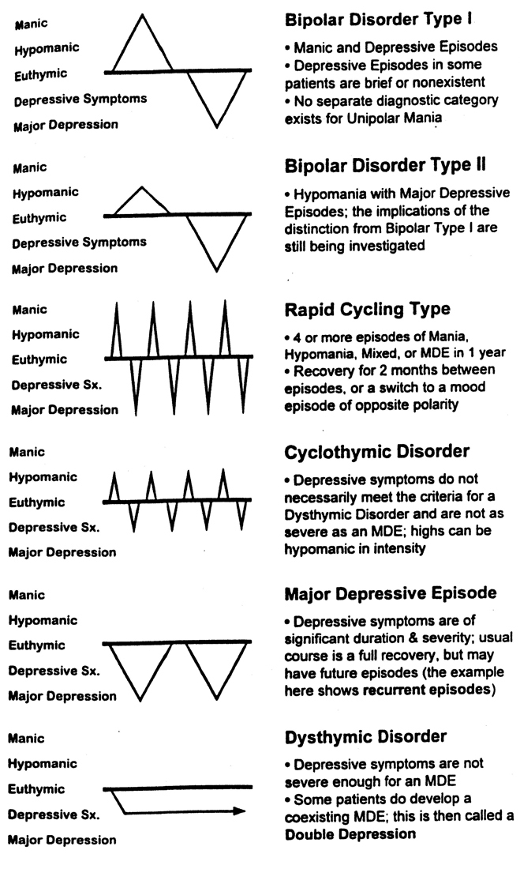
OVEOVERVIEW OF MOOD DISOR DISORDERS

Slide 4
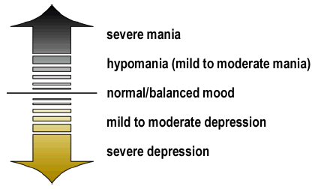
Diagnosis

Slide 5
Introduction:
Lifetime Prevalence
Major Depressive Disorder
  Women = 10-25%
  Men = 5-12%
Dysthymia = 6%
Bipolar Disorder
  Type I = 0.4-1.6%
  Type II = 0.5%

Slide 6
Introduction:
Facts about Depression
By the year 2020, the World Health Organization (WHO) estimates that depression will be the number two cause of "lost years of healthy life" worldwide.
Depression is a chronic and recurrent illness
Depression is associated with:
2 x increased risk of death
overall 26 x increased risk of suicide

Slide 7
Introduction: Cont’d…
2 -5 x increase in days absent from work
Impaired social function
Depression: Facts
Depression increases vulnerability to cardiovascular disease;
4-5 x increased mortality post MI
Depression is a risk factor of cardiovascular disease, stroke, diabetes

Slide 8
DSM-V Criteria for Major Depressive Disorder(MDD)
Depressed mood or a loss of interest or pleasure in daily activities for more than two weeks.
Mood represents a change from the person's baseline.
Impaired function: social, occupational, educational.
Specific symptoms, at least 5 of these 9, present nearly every day

Slide 9
Cont’d…
1.Depressed or irritable mood most of the day, nearly every day, as indicated by either subjective report (e.g., feels sad or empty) or observation made by others (e.g., appears tearful).

Slide 10
Cont.
2.Decreased interest or pleasure in most activities, most of each day
3. Significant weight change: (5 %) or change in appetite
4. Change in sleep: Insomnia or hypersomnia
5. Change in activity: Psychomotor agitation or retardation
6. Fatigue or loss of energy
7. Guilt/worthlessness: Feelings of worthlessness or excessive or inappropriate guilt
8. Concentration: diminished ability to think or concentrate, or more indecisiveness
9. Suicidality: Thoughts of death or suicide, or has suicide plan

Slide 11
Clinical features of Depression
5 or more for 2 weeks nearly every day:
  Mood depressed*
  Sleep ↑↓
  Interest ↓, libido ↓, social withdrawal*
  Guilt, hopelessness, worthlessness
  Energy ↓
  Concentration ↓, indecisiveness
  Appetite↑↓, weight ↑↓, loss of taste for food
  Psychomotor ↑↓
  Suicidal ideation, recurrent thoughts about death

Slide 12
Clinical Features of Depression Cont.
Mood
The central feature of Depression is low mood leading to lack of enjoyment and as a consequence the world seems dull and joyless
Characteristic feeling of the sufferer are quite different from normal sadness for example like one that follows bereavement

Slide 13
Clinical Features of Depression Cont.
General appearance
May disregard personal appearance as follows:
Dressing and grooming is neglected
Unknown personal hygiene
May wear a staring gaze – avoids eye contact
Behavior = reduced motor activities for example gestural movements are reduced
Facial features turning downward of the corners of the month
Some patients maintain a smiling exterior but with deep feelings of depression - This is called “masked depression – very dangerous.

Slide 14
Clinical Features of Depression Cont.
Psychomotor Retardation
Patient is slow in his mental and physical activity. This can be demonstrated in the patient’s speech which is slow (taking too much time to answer questions and pause in conversation, may be so long that they would be intolerable to a non depressed person.
He walks and acts slowly. May also present with psychomotor agitation.

Slide 15
Clinical Features of Depression Cont.
Anxiety – Common in mild depressive illness
Irritability – Tendency to respond with undue annoyance to minor demands.
Agitation – a state of restlessness which is experienced by the patient as availability to relax – sufferer paces up and down or wringing his hands

Slide 16
Cont’d
Reduced energy -Anergia – patient finds everything an effort and leaves tasks unfinished e.g. a normally active housewife may have the beds unmade and the dirty plates on the table – severely reduced in depressive sleeper
Lack of Interest and enjoyment
– The subject shows no enthusiasm for activities or hobbies that he would normally enjoy - Anhedonia

Slide 17
Clinical Features of Depression Cont.
Pessimistic Thoughts – These are important symptoms to note–
Patients see the unhappy side of every event
He perceives himself as a failure and he has no confidence
He cannot take any credit for any success he makes
Sees failure in his work
Sees future misfortunes
Foresees deterioration in his health
His future is clouded
He may describe his future as ‘black or bleak’ and sees no chance of improving the matter

Slide 18
Suicide is an ever present risk
World
All this leads to ideas of hopelessness and worthlessness
He sees death as a relieve
This may progress to suicidal ideas
Self
Future
Past

Slide 19
Clinical Features of Depression Cont.
Suicide is an ever present risk Cont…
His past is viewed with sense of guilt and self blame about minor matters e.g. a patient may feel guilty of past trivial acts of dishonesty or of letting somebody down which have not been disturbing him until now that he is sick.
This strongly suggests the illness is at an advanced stage

Slide 20
Clinical Features of Depression Cont.
Physical complaints –
Somatic symptoms can occur and have special clinical significance:
- Sleep disturbance characterized by early morning awakening, delay in falling asleep and waking during the night – all because the sufferer is preoccupied with painful thoughts.

Slide 21
Cont’d…
Could also present with excessive sleeping, poor appetite/excessive appetite leading to weight loss or gain
Patient may refuse to eat
Those who refuse to eat and lose weight should receive medical as well as psychiatric emergency treatment
Constipation is also common

Slide 22
Clinical Features of Depression Cont.
Memory
Memory is affected by poor concentration because this prevents new information from being registered properly
In elderly people impairment of memory is so severe that the clinical presentation resembles that of dementia (depressive pseudo-dementia)

Slide 23
Clinical Features of Depression Cont.
Psychotic features
Delusions: Convictions about his/her physical state of body might be expressed (hypochondriacal delusions)
Nihilistic delusions: he/she may believe that one certain body organs is missing
Delusions of worthlessness – believes that she is worthless and doesn’t deserve to live – base for suicidal thoughts.

Slide 24
Clinical Features of Depression Cont.
Hallucinations – Hallucinations involve unpleasant experiences e.g. auditory hallucinations are experienced as voices saying nasty things about the subject e.g. “you are not good; you deserve to suffer, kill yourself
Olfactory hallucinations of unpleasant scenes e.g. death or destruction

Slide 25
NB:
Remember: For diagnostic purposes symptoms must be present
most of the day
nearly every day
for at least 2 weeks and t
They must cause distress or impairment

Slide 26
CLASSIFICATION OF DEPRESSION:
Melancholia – A form of psychotic (endogenous) depression associated with middle age (45-65yrs).
Characterized by agitation and hypochondriacal symptoms (complaints of generalized non existent physical diseases)
Believed that the aetiology is the involution (Shrinkage) of sex glands

Slide 27
Cont’d…
Affects women more than men
Appears during the late 40s in women and late 50s in men when there are extensive changes in the body which have psychological significance e.g. anticipated loss of sexual attractiveness

Slide 28
CLASSIFICATION OF DEPRESSION:
Aetiological classification
Endogenous Vs Reactive (Exogenous)
Symptom Pattern classification
Psychotic Vs Neurotic
Degree of severity pattern
of classification
Major/severe Vs Minor/mild

Slide 29
COMPARE AND CONTRAST THE TYPES IN TERMS OF:
1. Aetiology
Endogenous/reactive Depression
Symptoms of endogenous depression are caused by factors from within the individual independent of outside factors – e.g. genetic factors.
Causation is mainly genetic and constitutional factors
Symptoms seem to arise out of the blues with no clear external precipitation
Though external stresses can provoke or sustain the illness, the relationship is less justifiable for it may follow a trivial incidence

Slide 30
Endogenous/reactive Depression
Symptoms of reactive (exogenous depression are as a response to the external stressors e.g. reaction to losses
The magnitude of the stressful factors is justifiable

Slide 31
COCOMPARE AND CONTRAST THE TYPES IN TERMS OF:
2. Symptoms
Anxiety symptoms are more common in neurotic depression while psychotic symptoms are more common in psychotic depression.
Early morning awakening is seen in psychotic depression.
In psychotic depression, the mood is persistently low and undistractable while in neurotic depression the mood fluctuates in line with the environment.

Slide 32
COCOMPARE AND CONTRAST THE TYPES IN TERMS OF:
2. Symptoms Cont…
Diurnal mood variation in psychotic depression the sufferer tends to be at his worst in the morning and improves as the day progresses
In neurotic depression the reverse tends to be the case with worsening as the day goes on

Slide 33
COCOMPARE AND CONTRAST THE TYPES IN TERMS OF:
2. Symptoms Cont…
Hypochodriasis is more common in neurotic depression
-The somatic complaints are multiple and may vary from day to day – affect different systems of the body and are paraded in an attention seeking manner.
-In psychotic depression, hypochondria can usually focus on one organ or system and are consistently held e.g. the patient may actually believe that he has cancer and is going to die.

Slide 34
COCOMPARE AND CONTRAST THE TYPES IN TERMS OF:
2. Symptoms Cont…
In neurotic depression, the sufferer tends to blame others for his predicaments than himself as seen in psychotic depression.
Suicidal thoughts and suicide is common in psychotic depression
While suicidal thoughts may be present in neurotic depression, suicide is rare.

Slide 35
COCOMPARE AND CONTRAST THE TYPES IN TERMS OF:
The following features only occur in psychotic type of depression:
Delusions: Alongside with hypochondriac ideas, the patient may have delusions of guilt, worthlessness, nilhistic or poverty.
Hallucinations: hallucinations , when present are in keeping with the depressive affect – he/she may have a variety of auditory hallucinations mocking him or plotting against him or olfactory hallucinations perceiving foul smell emanating from him; if visual hallucinations, may be seeing death scenes and destructions.

Slide 36
COCOMPARE AND CONTRAST THE TYPES IN TERMS OF:
Cont’d
Retardation: slowness of mental as well as motor activity tends to occur only in psychotic depression.
Appetite: Appetite in psychotic depression is poor resulting to weight loss but in neurotic depression, appetite is not lost

Slide 37
COCOMPARE AND CONTRAST THE TYPES IN TERMS OF:
3. History
Previous psychiatric History
The patient with psychotic depression might give a history of previous similar depression or an attack of mania
The neurotic depressive is likely to give a history of several depressive episodes with no attack of mania always precipitated by external understandable stress
-There may be a history of previous overt anxiety disorder e.g. anxiety state, obsessional neurosis or hysterical behavior in the neurotic depression

Slide 38
COCOMPARE AND CONTRAST THE TYPES IN TERMS OF:
Family History:
There may be evidence of psychiatric history in the family of psychotic depression.
Pre-morbid personality History:
The patient with psychotic depression may have a cyclothymic depression.
The neurotic depression tends to have a vulnerable or inadequate type of personality.

Slide 39
DEPRESSIVE STUPOR
The most severe state of depression
Characterized by feelings of total despair, hopelessness and worthlessness, feelings of nothingness and emptiness, apathy loneliness, sadness and inability to feel pleasure
Severe psychomotor retardation which is so severe that physical movements may come to a stand still
Sits in curled-up position
Because of the low energy level and related thought process, the individual may be unable to follow on suicidal ideas. However the desire in strong at this level

Slide 40
DEPRESSIVE STUPOR Cont’d…
Physiological - the general slowdown of the entire body leads to:
- sluggish digestion,
constipation and urinary retention,
amenorrhea, impotence,
diminished libido,
anorexia,
weight loss,
difficult falling asleep and awakening very early in the morning

Slide 41
ETIOLOGY
GENETICS
Research has revealed relevance of hereditary factors in causation of depression
Twin studies suggest a genetic factor in the illness because about 50% of monozygotic twins are concordant for the illness (Concordant refers to twins who are both affected with the illness) even if they are raised apart in different environments.

Slide 42
ETIOLOGY Cont’d…
Family studies: most family studies have shown that major depression is more common among 1st degree biological relatives of people with the disorder than among the general population.
Adoption studies: have shown that the biological children of the affected parents remain at increased risk of a mood disorder (depression) even if they are reared in non affected families

Slide 43
ii. BIOCHEMICAL INFLUENCE
It has been hypothesized that depressive illness may be related to deficiency of the neurotransmitters norepinephrine, serotonin and dopamine at important receptor sites in the brain.

Slide 44
BIOCHEMICAL INFLUENCE Cont’d…
This hypothesis grew out of the observation that reserpine which depletes the brain of amines was associated with the development of depressive syndrome
A depletion of these neurotransmitters inhibits the transmission of impulses from one neuronal fiber to another causing a failure of the cells to fire or become charged

Slide 45
Monoamine Hypothesis of Depression
"Norepinephrine”: related to alertness and energy as well as anxiety, attention, and interest in life.
Serotonin: related to anxiety, obsessions, and compulsions.
Dopamine: to attention, motivation, pleasure, and reward, as well as interest in life.“

Slide 46
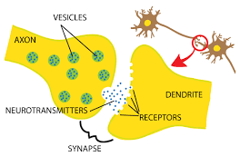

Slide 47
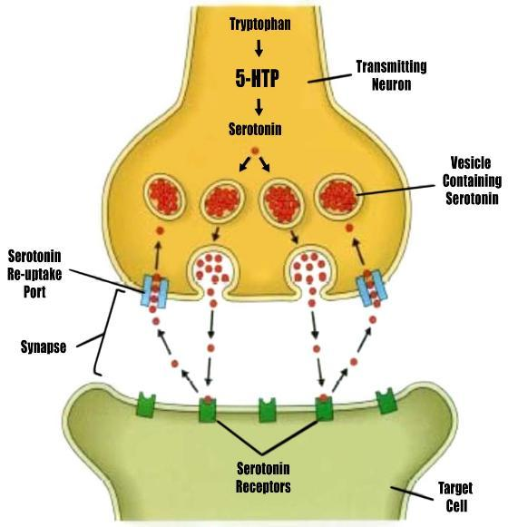

Slide 48
iii. ENDOCRINE DISTURBANCE
May play a role in the persistence of depressive illness. This notion has risen in view of the marked disturbance in mood observed with the administration of certain hormones
In clients who are depressed, the normal system of hormonal inhibition fails resulting in hyper secretion of cortisol leading to depressive symptoms.

Slide 49
iv. NEUROLOGICAL DISORDER
Brain tumors particularly in the area of the temporal lobe often cause symptoms of depression
Agitated depression may be part of the clinical picture associated with Alzheimer’s disease, Parkinson’s disease and Huntington's chorea
Agitation and restlessness may also represent an underlying depression in the individual with multiple sclerosis

Slide 50
v. ELECTROLYTE DISTURBANCES
Excessive levels of sodium bicarbonate or calcium can produce symptoms of depression as can deficit in magnesium and sodium
Excess of potassium in the body have also been observed to cause depressive symptoms as well as in instance of potassium depletion
An imbalance of estrogen-to-progesterone ratio during the initial phase of the menstrual cycle is responsible for the symptoms associated with premenstrual syndrome.

Slide 51
vi. NUTRITIONAL DEFICENCES
Deficiencies in B-Vitamines, Vitamins C, potassium may produce symptoms of depression
Depression Secondary to:-
Physical Disease: some diseases are painful and stressing and may lead to depression e.g. terminal illness

Slide 52
THEORIES
Psychoanalytical Theory
Freud observed that depression occurs after the loss of a loved one or object
He indicated that in depression, the person’s ability to adjust is internally affected because of identification with the lost object.

Slide 53
Theories (Cont’d…)
Learned Helplessness
Helplessness exists in a person who has experienced numerous failures
The individual abandons any further attempts to succeed and lacks control over his/her life situation

Slide 54
Learned Helplessness cont.
They become depressed because they feel helpless; they have learned that whatever they do is futile
This can especially be very damaging in life because the sense of mastery over ones environment is an important foundation for future emotional development – could be a symptom rather than causative factor

Slide 55
Theories (Cont’d…)
Physique and Personality
Persons of pyknic body build are particularly more predisposed to affective illnesses.
Cylothymic personality
People with repeated and sustained mood swings are more prone to develop manic – depressive disorder

Slide 56
Theories (Cont’d…)
Environmental Factors
Early childhood experience; maternal deprivation, childhood deprivation of maternal affection through separation or loss predisposes to depressive disorder in adult life
The theory of object loss suggests that depression occurs as a results of having been abandoned by or otherwise separated from a significant other during the first six months of life – Because during this period the mother represents the child’s main source of security; she is the object.

Slide 57
Environmental Factors Cont…
The response occurs not only with a physical loss – this absence of attachment which may be either physical or emotional, leads to feelings of hopelessness and despair that contribute to lifelong pattern of depression in response to loss.
Maternal deprivation which results from this separation (in children) includes behaviors such as excessive crying, anorexia, withdrawal, psychomotor retardation, stupor and a generalized impairment in the normal process of growth and development

Slide 58
Theories (Cont’d…)
Life Events
It has been found out that depressive disorders often follow stressful events like:
Various types of losses
Demanding events
Pressures of living
Dysfunctional marital relationship leading to divorce or separation
Socio economic factors; periods of extreme poverty

Slide 59
Theories (Cont’d…)
Psychoanalytic Theory It is f
Freud theorized that loss of a loved object evokes hostile and aggressive impulses which arise from unconsciousness
These feelings conflict with ego responses which are more +ve
The punitive super ego enters to intervene in the ID impulses

Slide 60
Theories (Cont’d…)
Psychoanalytic Theory cont…
When the psychic battle rages between ID and super ego the patient experiences guilt and self depreciation
Hostile & aggressive feelings are turned inwards and vented to self
In mania, the individual tries to cover up their low self esteem by utilizing the defense mechanism of projection
He projects a lot to others
His anxiety, hostility and guilt is a way of solving problems

Slide 61
Psychoanalytic Theory Cont’d
He may be boastful, aggressive, hyperactive to cope with his anxiety
He appears happy to cope, with painful situations in his conscious.
Mania is viewed as masking depression.
The disease is precipitated by some deep personal traumatic loss
He projects to the person/object within the environment
He appears boastful, quite demanding, sarcastic, hostile, overactive, violent and determined.

Slide 62
MANAGEMENT
CHEMOTHERAPY
Not necessary for mild depression which is as a result of environmental stress and crisis.
This tends to resolve spontaneously with simple Rx. Such as supportive Rx.
But a persistent low mood from which the patient cannot be distracted together with somatic features (early morning awakening and diurnal mood variation and loss of weight or appetite is an indication for commencement of drugs
Antidepressants
used to raise pts low mood and hence the patient may see himself worthy living.

Slide 63
MANAGEMENT (Cont’d…)
Drugs used:
Tricyclics:
1st line of chemotherapy: their mode of action relates to the amine hypothesis.
They act by preventing the reuptake of neurotransmitters (amines) at the neuron.
Onset of their effects is relatively slow (2-4 wks) but side effects can develop after 2nd dose.
Since the onset of their effects is slow they should be taken 5-6 weeks before course of treatment is said to be ineffective

Slide 64
Tricyclics Cont…
Are very dangerous in over dosage and maximum caution should be taken when being administered to suicidal patients
To be prescribed with caution to the elderly people as normal dose for a young adult would prove to be toxic in an older person
Observe for increment of mood changes into mania.
Tricyclics included in the Rx. of Depression are:
amtiriplyline (laroxyl)
It has a sedative effect so it is helpful in inducing sleep and relieving of agitation . - Dosage 25 – 75 mgs nocte

Slide 65
MANAGEMENT (Cont’d…)
MONOAMINE OXIDASE INHIBITORS (MAOIs)
Indicated for persistent depression that defies response to the 1st line of treatment
Rarely used because of their side effects.
The (MAOls) work differently: Instead of blocking reuptake of neurotransmitter, they block the activity of MAO, an enzyme that breaks down the neurotransmitters
They interact dangerously with certain drugs and food stuffs that contain tyramine e.g. certain wines, cheese yeast extracts and smoked fish.

Slide 66
MANAGEMENT (Cont’d…)
MONOAMINE OXIDASE INHIBITORS (MAOIs) Cont.
MAOIs may also interact dangerously with alcohol, barbiturates, hypertensive drugs like methyldopa
This interaction initiates hypertensive crises characterized by occipital headache which may radiate frontally; palpitations, neck stiffness, nausea vomiting, sweating dilated pupil, tachycardia or brandycardia, chest pain and possible cerebral hemorrhage.

Slide 67
MONOAMINE OXIDASE INHIBITORS (MAOIs) Cont.
Patients receiving MAOIs should carry a Rx card which warms of these possible interactions to advise attending physicians against prescribing potentially dangerous drugs.
Selective serotonin reuptake Inhibitors (SSRI) e.g. fluoxetine same as tricyclics but safer in side effects and overdose.

Slide 68
MANAGEMENT (Cont’d…)
ECT
Recommended for severe depression especially those with marked weight loss, suicidal ideas and psychomotor retardation, depressive stupor and somatic features, depressive delusions, failure to respond or comply with drugs
Exactly how ECT works remains unclear but the seizure most likely modifies the chemical environment of neurotransmitters. May be, it increases the sensitivity of synaptic monoamine receptors in the brain.

Slide 69
NURSING CARE
In the acute phase one to one interaction is recommended before the patient is introduced to a wider scope of interpersonal social relationship.
As the patient progresses he is introduced into group therapy
Raise the patients self esteem realistically through acceptance
Provide a therapeutic environment; safe and supportive)
If suicidal ideas are present enough precaution should be taken to prevent suicide
NB: (Read: Notes on management of patients with suicidal intentions) including printing up a suicidal caution card whereby patients behavior is closely monitored

Slide 70
NURSING CARE Cont
Avail yourself to the patient so that he can feel accepted and this may assist in abolishing feelings of worthlessness
Patient should be talked to even if he/she is mute
Provide suitable recreational activities so that the patient may not be preoccupied with suicidal ideas
Nurse in a quiet, comfortable environment
Involve the patient in simple non challenging activities
Encourage him/her to groom self which will contribute to the self esteem

Slide 71
NURSING CARE Cont.
Avoid behaviors that will confirm ideas or delusions of worthlessness
Convey attitude of caring verbally and non-verbally
Physical Needs: Patient has no energy to meet his physical needs like feeding – provide with small amounts of attractive foods
For severe ones, put an output and input chart and if completely unable to feed put on N/G tube feeding.
Personal hygiene- supervised and where possible assist the pt to have a bath and change into clean clothes

Slide 72
NURSING CARE Cont.
Encourage hygiene by rewarding the patient positively on any move she makes towards glooming
For good sleep provide warm and quiet environment and observe sleep pattern
Perform MSA periodically to assess the progress
O.T helps in diversion of patients mind from delusions and hallucinations; thus preventing further deterioration of pts illness
- It stimulates interests as well as raise self esteem through the feeling of doing something useful and pride in achievement

Slide 73
NURSING CARE Cont.
- It also diverts the patients attention from himself onto other things
- It offers retraining in areas where skills have been diminished
Group therapy
For mild depression, nursing care is aimed at helping the patient cope up with his problems, find solutions to his problems and continue performing his normal responsibilities
Involve social worker if there is psychosocial problem precipitating or perpetuating the illness.

Slide 74
NURSING CARE Cont.
Family and marital psycho educational intervention increases clinical stability and reduced hospitalization as well as having other functional and psychosocial benefits
This education involves the nature of the illness; the role they play in the management of the patient; health message on drug compliance; clinic attendance.
Home visit before discharge
Involve the employer
Community resources
Follow up care, home visits after discharge

Slide 75
Thanks

